Slide 1
Time magazine
Person of the Year

Slide 2
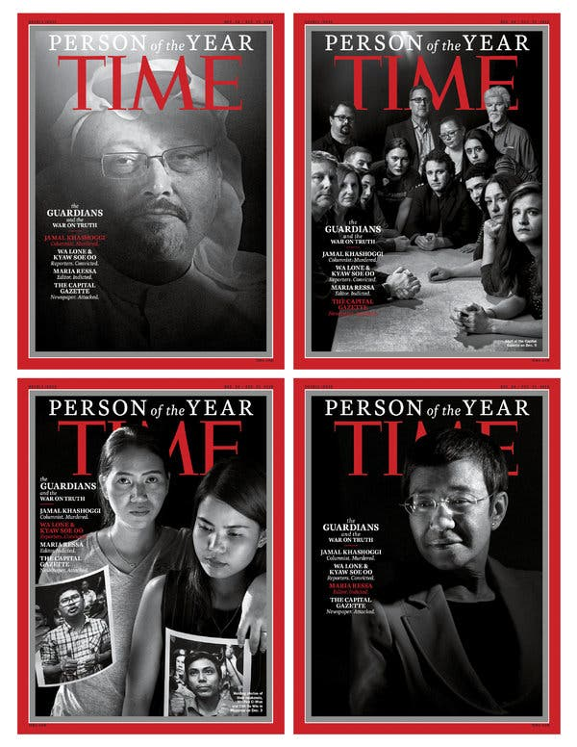
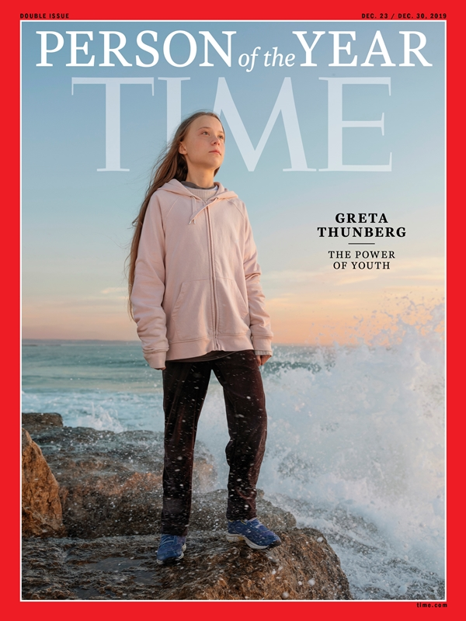

Each year, Time creates a list of candidates for their “Person of the Year” edition. Readers vote in, and the winner is featured on the cover with an article inside the magazine. Check out two recent examples from 2018 and 2019.

Slide 3
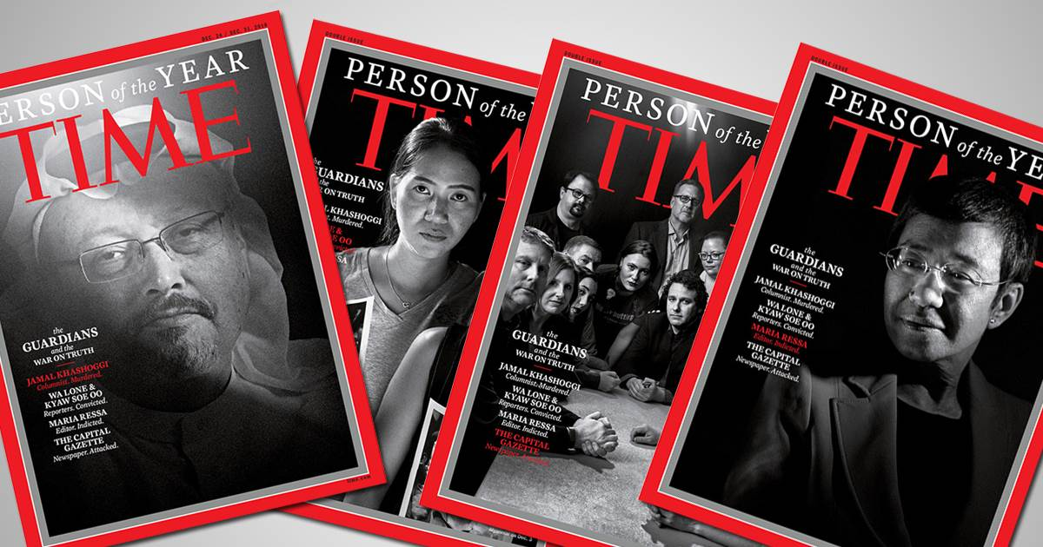
Note the addition of text:
Identification of person/group of the year
A brief description/introduction
NOTE: 2018’s Person of the Year named The Guardians, or those involved in journalism. There were four different covers, and the brief description/intro read “War on Truth.”

Slide 4
Note the addition of text:
Identification of person/group of the year
A brief description/introduction
NOTE: 2019’s identifies the person as Greta Thunberg with a description/intro of “The Power of Youth”

Slide 5



Your Task:
Put yourself on the 2020
Time
“Person of
the Year”
cover

Slide 6

1. You can either download a blank Time “Person of the Year” template/put it into a word document (see last slide) or upload your pic into an online template: http://magazineyourself.com/create/17
*Note…once you’ve uploaded your pic, just screencap from there; you don’t need to “save and continue” to download the program. Your cover doesn’t need to be full size, but please make it fill about a half sheet of paper. Scissor-cut it down to size before submitting so it looks more authentic.
2. You will need to add text (like the samples. Feel free to use Word or another digital editing program).
Identify yourself
Create a brief subtitle/explanation/introduction (think about what would make you news-worthy. Please be attentive to your tone.)
3. Include a typed (doubled spaced, 5-7 sentences), paragraph explaining more about why Time has selected you for its cover (be creative!).
DIRECTIONS

Slide 7
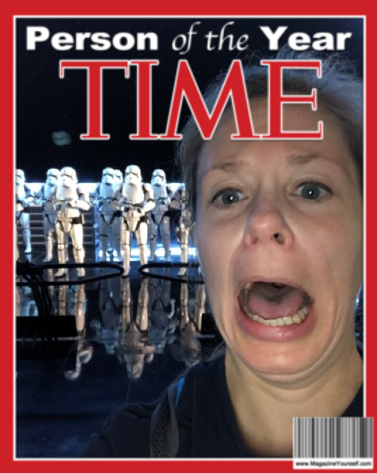
Date: December 2019. Mission: Join the resistance and destroy the First Order. As I boarded the fighter plane and received my instructions, I was jolted by a sudden attack. The First Order was upon us, and our capture led us into the merciless hands of Storm Troopers and the bowels of enemy spacecraft. As a committed Jedi, I was defiant. I joined other rebels, hopped on a hovercraft, and began the escape. Skidding through hallways, dodging light sabers, sliding under AT-ATs, I avoided the menacing Kylo Ren and his Dark Side forces. Scoring one for the Resistance, I now humbly accept Time’s honor as Person of the Year.
(On a trip to Disney World I was excited to learn that the newest Star Wars ride “Rise of the Resistance” opened the day before I arrived. Best. Ride. Ever.)
Teacher’s Sample

Slide 8
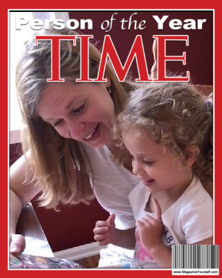
Sample 2
*Note: just ideas for paragraph
In my follow-up paragraph, I would explain about the most important role that I play: Bestie. After my niece, Emma, was born in 2015, “Aunt Colleen” seemed so tedious; my brother came up with “Bestie,” and it stuck. So, I could take a sentimental tone as I tell you about how much she melts me, like when she sang “Can’t Stop the Feeling” as she twirled through Target; or when she trips and falls, only to bounce up and exclaim, “I’m okay, guys!”; or when we eat choco tacos on the beach; or when she finishes the sentences as we read our favorite stories.
COLLEEN
REMAR
----
BESTIE

Slide 9

When you bring your work to class, you
need:
Your cover, printed in color and blown up to about half a sheet of paper (or bigger! ☺). Make sure you cut off extra white space so it really looks like a cover.
Your brief paragraph/explanation, typed and clipped to the cover. You should aim for about 5-7 sentences.
*If you don’t have a color printer, see me
in advance of the due date for a pass to
the library.
SUBMISSION REMINDERS

Slide 10


If you want to work with a blank template, and edit from there try these:
http://1.bp.blogspot.com/_GfqMyDmvo3M/TPbHDrLm-JI/AAAAAAAAAxo/-2gcywWE91E/s1600/TIME+Template.jpg
http://www.wikihow.com/images/thumb/6/62/2012-04-29_1312_700.png/537px-2012-04-29_1312_700.png

